Slide 1
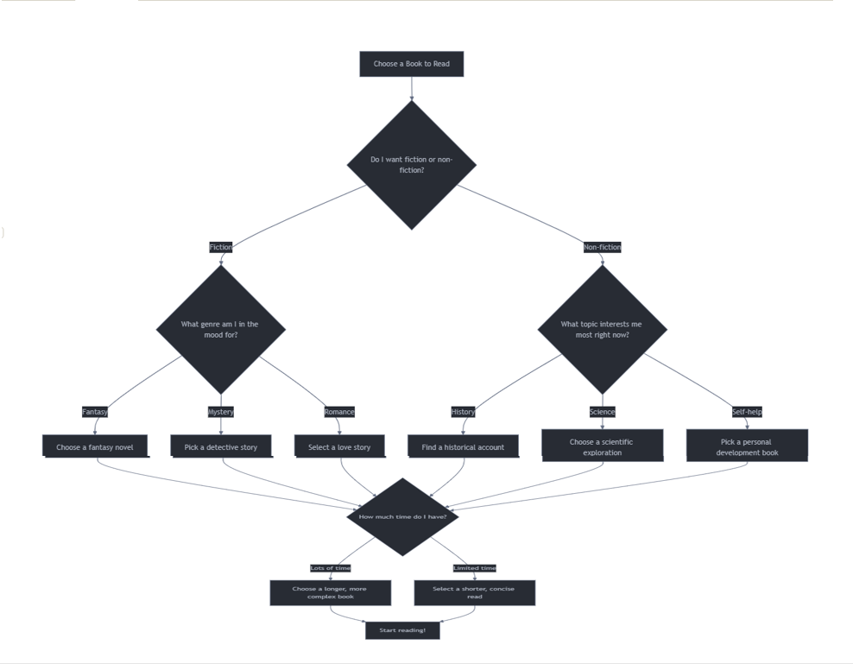
Notes:
This decision tree visualizes the process of choosing a book to read. Here's a brief description of the decision-making process:
The root node represents the initial decision to choose a book.
The first major decision is between fiction and non-fiction.
If fiction is chosen, the next decision is about the preferred genre (fantasy, mystery, or romance).
If non-fiction is chosen, the decision branches into different topics of interest (history, science, or self-help).
After selecting a specific type of book, the final consideration is the amount of time available for reading, which influences whether to choose a longer, more complex book or a shorter, more concise one.
The decision tree concludes with starting to read the chosen book.
This tree helps visualize the multiple factors that go into selecting a book, from broad categories to specific preferences and practical considerations. It demonstrates how a seemingly simple choice can involve several layers of decision-making.

